Slide 1
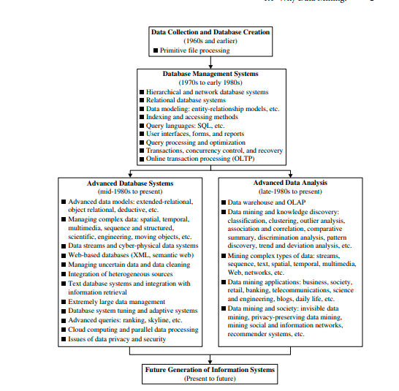
Evolution of Datamining

Slide 2
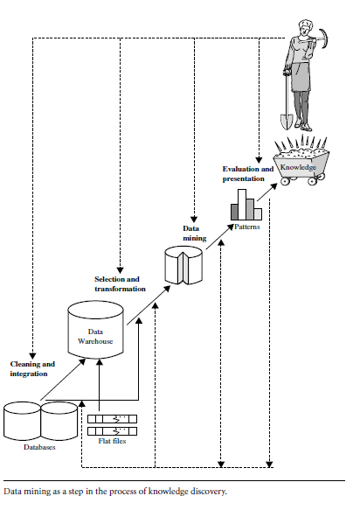
Knowledge Discovery from Databases (KDD)

Slide 3
KDD: Knowledge Discovery from Data
1. Data cleaning (to remove noise and inconsistent data)
2. Data integration (where multiple data sources may be combined)
3. Data selection (where data relevant to the analysis task are retrieved from the database)
4. Data transformation (where data are transformed appropriate form for mining by performing summary or aggregation operations)
5. Data mining (an essential process where intelligent methods are applied to extract data patterns)
6. Pattern evaluation (to identify the truly interesting patterns representing knowledge based on interestingness measures.
7. Knowledge presentation (where visualization and knowledge representation techniques are used to present mined knowledge to user understandable format.

Slide 4
Data characterization is a summarization of the general characteristics or features of a target class of data. The data corresponding to the user-specified class are typically collected by a query. For example, to study the characteristics of software products with sales that increased by 10% in the previous year, the data related to such products can be collected by executing an SQL query on the sales database
Example:
A customer relationship manager at AllElectronics may order the following data mining task: Summarize the characteristics of customers who spend more than $5000 a year at AllElectronics. The result is a general profile of these customers, such as that they are 40 to 50 years old, employed, and have excellent credit ratings. The data mining system should allow the customer relationship manager to drill down on any dimension, such as on occupation to view these customers according to their type of employment

Slide 5
Data discrimination
If we want to compare two groups of customers—those who shop for computer products regularly (e.g., more than twice a month) and those who rarely shop for such products (e.g., less than three times a year). The resulting description provides a general comparative profile of these customers, such a

Slide 6
Data mining: Finding out the inherent structure of data:
Techniques of DM:
Supervised problem is solved by Supervised learning/Classification:
we get the Class of the instances
Unsupervised problems is solved by Unsupervised learning/Clustering:
We get inherent grouping of the dataset
Association Rule Mining:
Design Rules

Slide 7
DM can be applied to various kinds of data:
Database data: (relational data)
Data warehouse data:
Transaction data:
Sequence data: (historical records, time series data, stock exchange data)
Data streams: sensor data: (continuously transmitted)
Spatial data: (maps)
Engineering design data: (design of building)
Hypertext and multimedia data: text,image, videos
Graph and network: social media data

Slide 8
Data Mining
Extraction of hidden, previously unknown, and potentially useful information from the large amount of data.
We can mine Relational data, network data, temporal data and many more.

Slide 9
Before Data mining
After Data mining
Data Cleaning
Missing
Noisy
Data Reduction
Data Transformation
Dimensionality Reduction
Numericity Reduction
Data Compression
smoothing
Attribute Subset Selection
Aggregation
Normalisation
Class of newly arrived record
or
Inherent Groups in dataset
or
Rules exist in dataset
Or
Interesting Patterns
DM
(Useful Information)
(Pre-processing of dataset as the input is raw data)

Slide 10
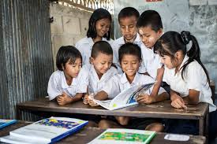
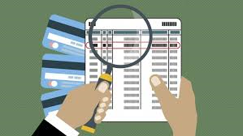



Applications of DM

Slide 11
Data Mining Techniques
ASSOCIATION RULE MINING
CLASSIFICATION
CLUSTERING
Sales data
TRANSACTIONS | ONION | POTATO | BURGER | MILK | COKE_BUY
T1 | 1 | 1 | 1 | 0 | 0
T2 | 0 | 1 | 1 | 1 | 0
T3 | 0 | 0 | 0 | 1 | 0
T4 | 1 | 1 | 0 | 1 | 0
T5 | 1 | 1 | 1 | 0 | 1
T6 | 1 | 1 | 1 | 1 | 1

Slide 12
Association Rule mining
Frequent patterns: (100)
Buys(computer) => buys(Antivirus) [Support=1%, Confidence=50%]
Age (X,20) ^ income (X, 40K) => (X, laptop)

Slide 13

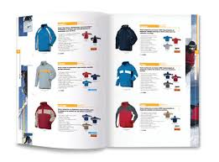

Applications of ARM

Slide 14
Classification
It is a form of data analysis that extracts models describing important data classes.
A classification task begins with a data set in which the class assignments are known.
Create
MODEL
Training data
Classify new data
Validation
Testing data
Calculate the performance
Measures:
Accuracy
Precision
Recall

Slide 15

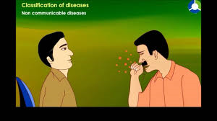
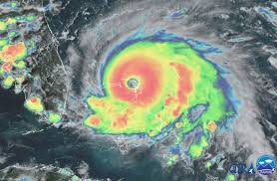
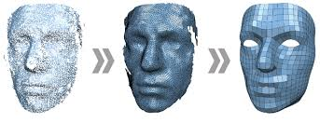
Application of Classification

Slide 16
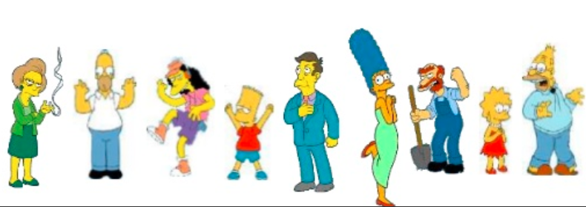
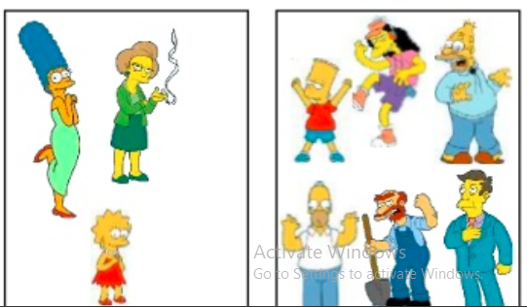

Clustering
Clustering is the process of grouping a set of data objects into multiple groups/ clusters. Objects within cluster have high similarity whereas objects of other clusters are dissimilar.

Slide 17
Thank u

Slide 18
Clustering
Clustering is the process of grouping a set of data objects into multiple groups/ clusters. Objects within cluster have high similarity whereas objects of other clusters are dissimilar.
Inherent Structure
Unusual behaviour
Clustering
Partitioning
Hierarchical
Divisive
Agglomerative
K-means

